Slide 1
Sprint 3 Meeting
Team sixteen - Intern

Slide 2
CONTENTS
Sprint Review
Sprint 4 planning
1
2

Slide 3
Sprint 3 goals
1
Register
Deregister
2
Voice call setup
Voice call release

Slide 4
1
User Story – Registration
2 story points
Register
Deregister function
GUI
1
2

Slide 5
1
Test - Registration
Function Test
Manual
Positive
Negative
Method
Pass

Slide 6
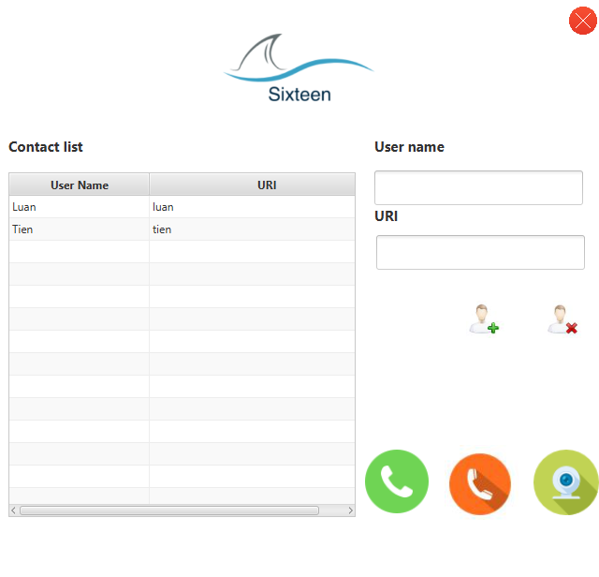
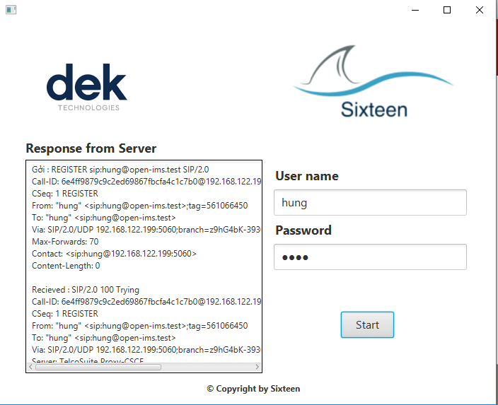
1
Test - Registration
Function Test - Positive
Register with correct
username and password
Pass

Slide 7
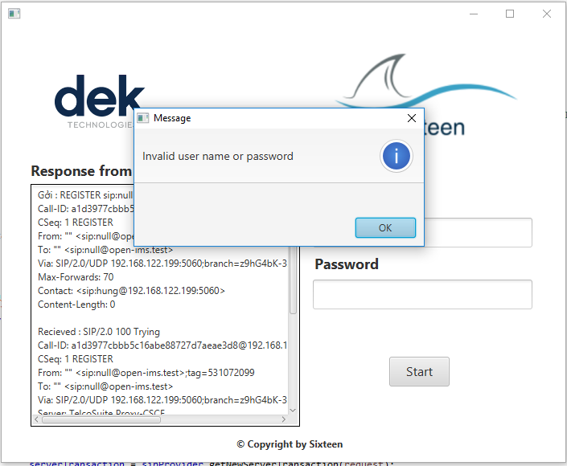
1
Test - Registration
Function Test - Negative
Username
Password
null

Slide 8
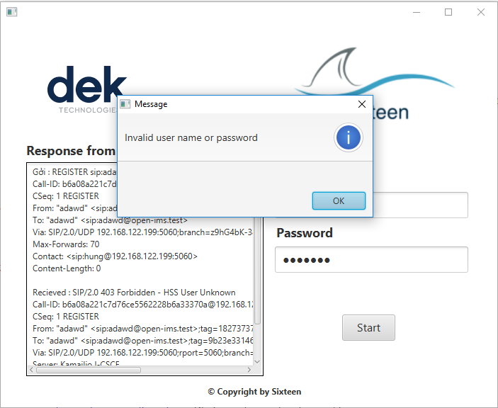
1
Test - Registration
Function Test - Negative
Username
Password
incorrect

Slide 9
1
Registration
Re-check
Register
Deregister function
GUI
Done
Done

Slide 10
2
User Story - Voice call
20 story points
Setup
Release
Transfer voice
GUI
1
2
3
4

Slide 11
2
User Story - Voice call
Function test
Caller
Callee
1
2

Slide 12
2
User Story - Voice call
Caller & Callee
Demo

Slide 13
2
User Story - Voice call
System test
Not have system test yet

Slide 14
2
User Story - Voice call
Re-check
Setup
Release
Transfer voice
GUI
Done
Done
Done
Done

Slide 15
Sprint 4 planning
Video call setup
Video call release

Slide 16
Definition of done – Video Call
Setup
Release
Transfer voice
GUI
1
2
3
4

Slide 17
Test – Video Call
Manual
Function test
1
2

Slide 18
User story – Video Call
24 story points

Slide 19
Sprint Goals
Setup
Release
Video call

Slide 20
Q&A

Slide 21
Thank you

